Slide 1


Infosys
NarrativeNexus
AI-Driven Text Analysis Platform
PRESENTED BY
VINEELA PAGOLU

Slide 2

Problem Statement
Large volumes of unstructured text such as news articles and reports make manual analysis time-consuming and inefficient. There is a strong need for automated systems that can extract insights, summarize content, and analyze sentiment effectively.

Slide 3

Project Objective
The goal of NarrativeNexus is to automate text analysis through efficient topic extraction, sentiment identification, and summarization, all while providing a user-friendly interface that simplifies complex machine learning processes.

Slide 4
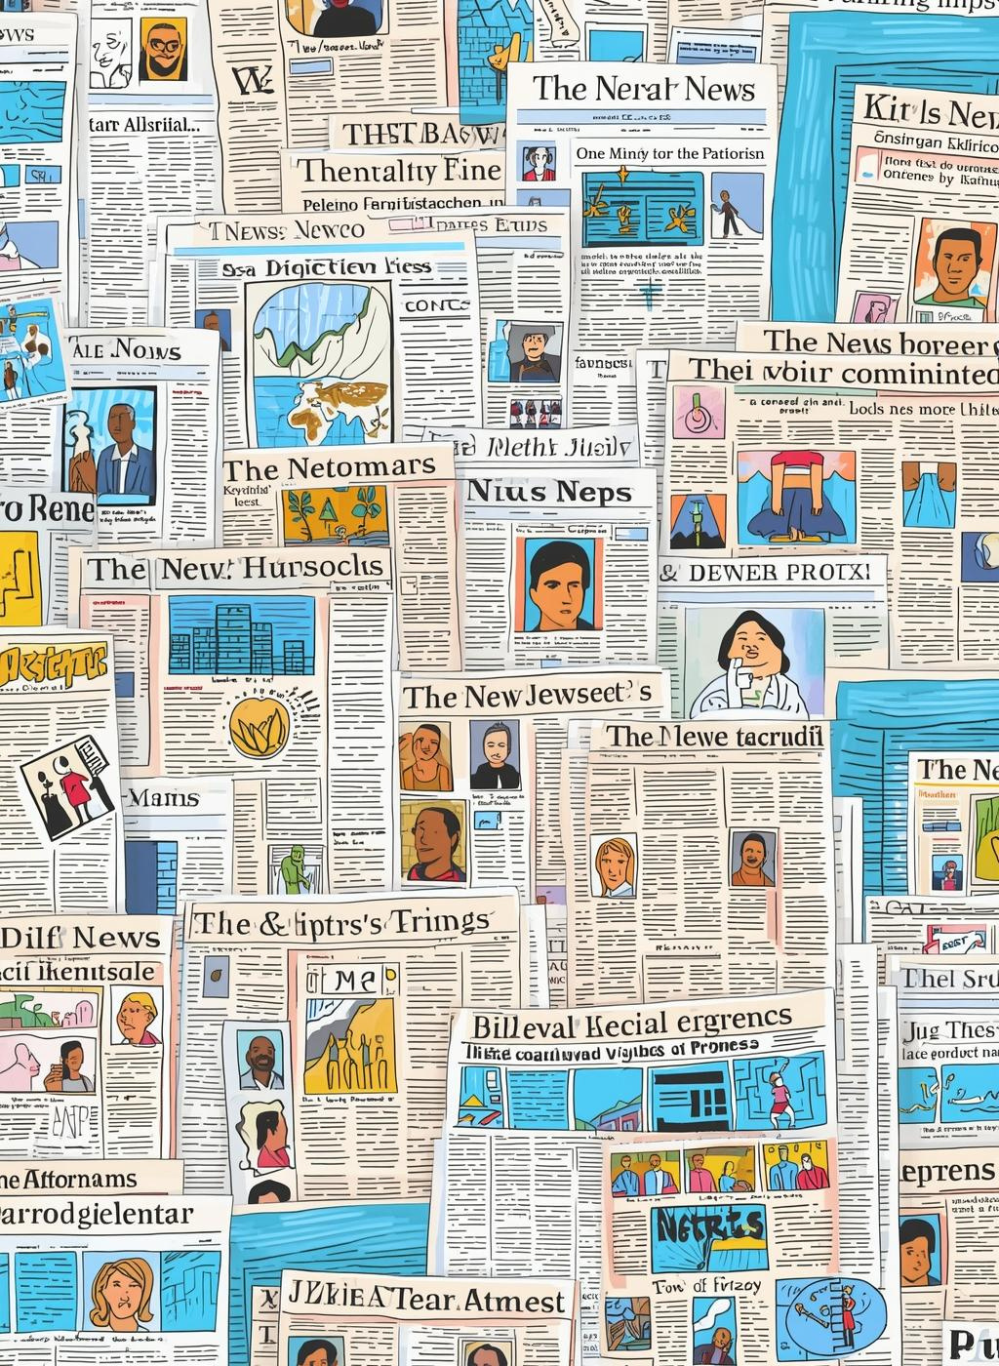
Dataset Overview
The project utilizes the BBC News Dataset, containing real-world unlabeled articles, justifying our choice of an unsupervised learning approach for effective analysis and topic modeling.
The dataset used contains 2,225 records with 17 columns, representing news-related textual data.
The data is primarily unstructured text, suitable for natural language processing tasks.

Slide 5
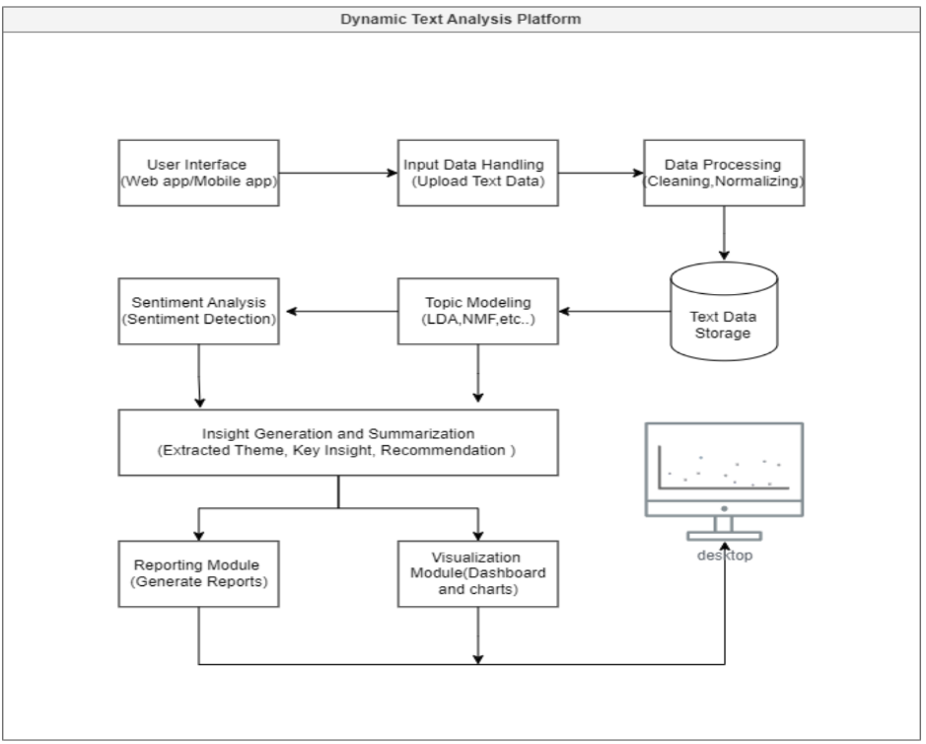
System Architecture
This section outlines the high-level flow of our platform. It illustrates how data is processed, from input to preprocessing and ultimately to user-friendly visual outputs.

Slide 6
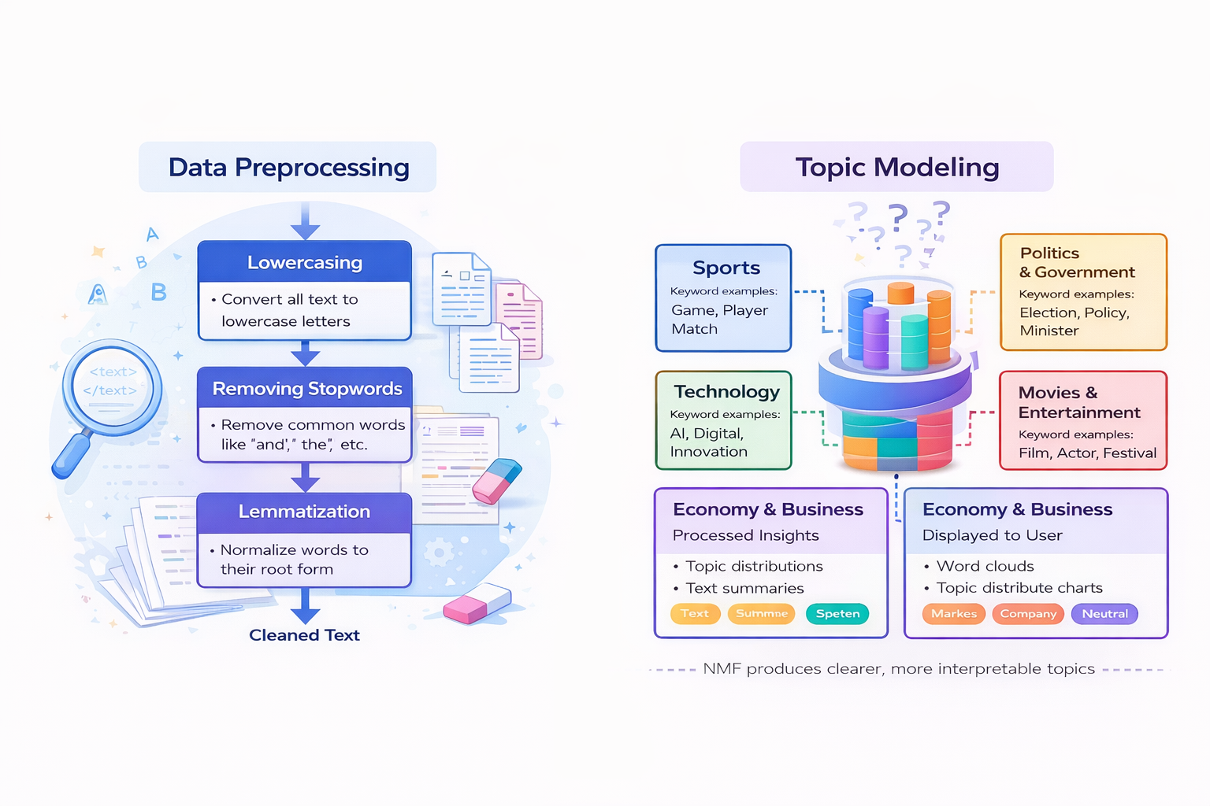
Data Preprocessing Steps
Effective data preprocessing is essential for enhancing the quality of text analysis. This involves steps such as lowercasing, punctuation removal, stopword removal, and lemmatization to prepare data for modeling.

Slide 7
Topic Modeling Overview
Topic modeling is a crucial technique in natural language processing that helps identify underlying themes in large text corpora, enabling more efficient analysis through automated methods like LDA and NMF.

Slide 8
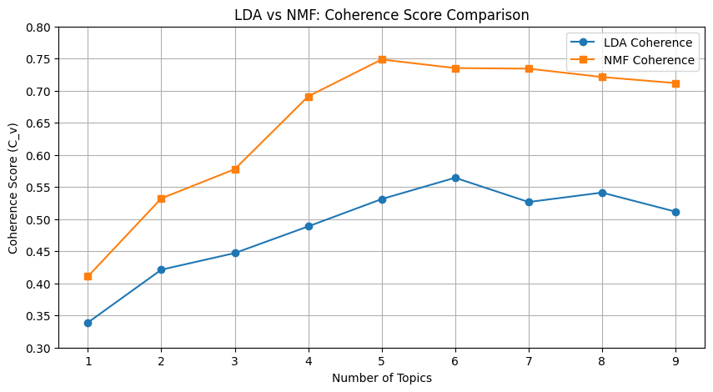
LDA vs NMF Comparison
LDA METRICS
LDA (Latent Dirichlet Allocation) provides a coherence score based on word distribution across documents, emphasizing interpretability but facing challenges with overlapping topics, leading to less distinct groupings.
NMF METRICS
NMF (Non-negative Matrix Factorization) excels in achieving clearer topic separation, resulting in higher coherence scores and enhanced interpretability, making it more suitable for distinct topic modeling in diverse datasets.

Slide 9

Final Topic Modeling
The final model identified five key topics: Sports, Politics, Technology, Entertainment, and Economy, highlighting diverse themes within the dataset for targeted analysis and user relevance.

Slide 10
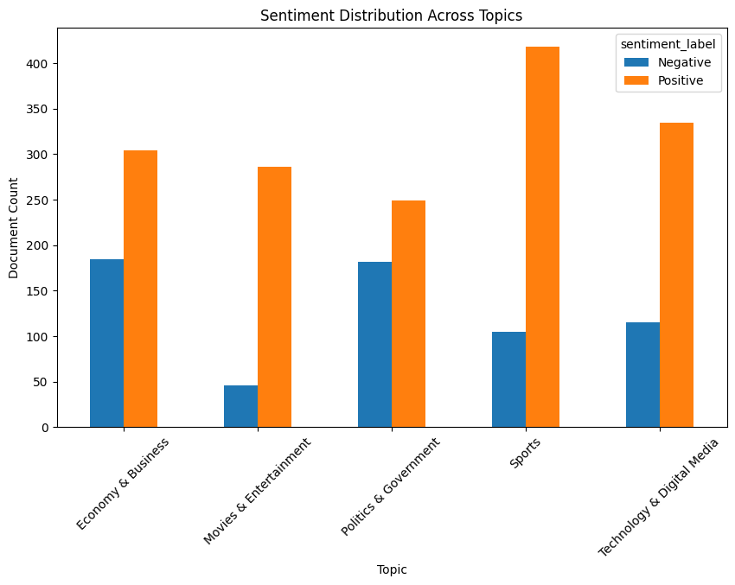
Sentiment Analysis
This section introduces the VADER Sentiment Analyzer, focusing on its ability to classify text as positive or negative, offering insights into public sentiment effectively and efficiently.

Slide 11
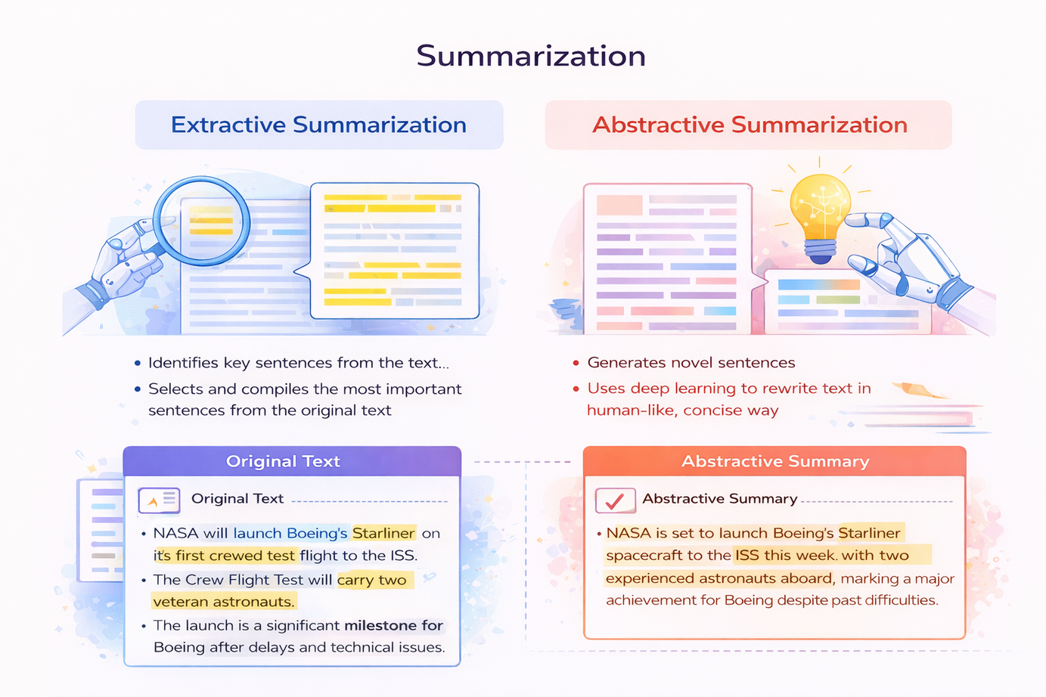
Summarization Methods
This section explores the differences between extractive and abstractive summarization, highlighting why abstractive methods are often more human-like in creating coherent summaries from text.

Slide 12
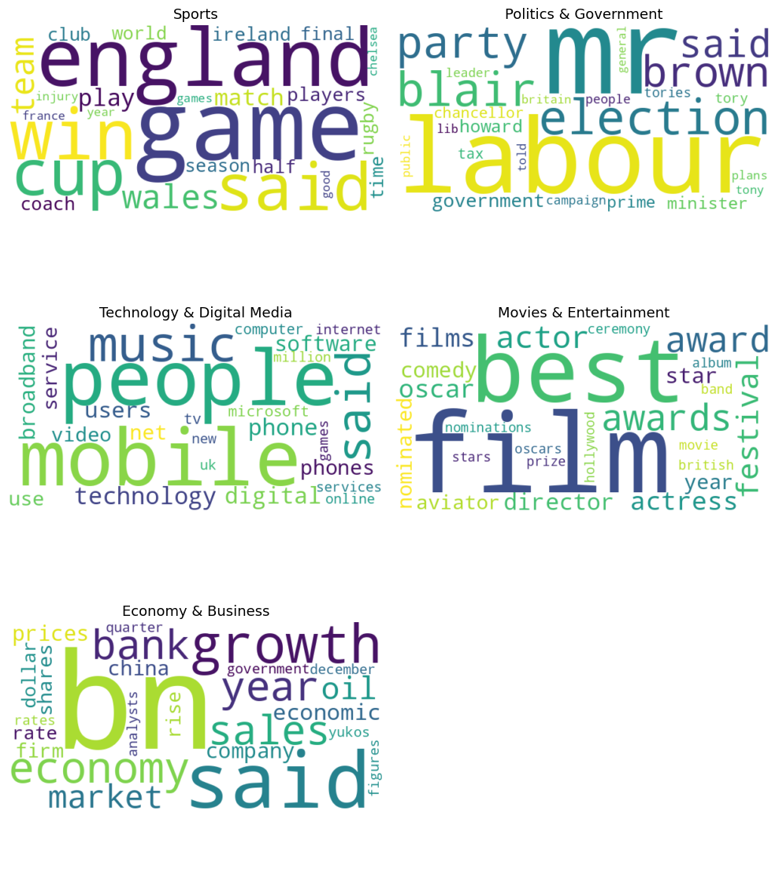
Visualizations Overview
This section presents data visualizations, including topic distribution charts, word clouds, and sentiment graphs, to effectively communicate our analysis results and insights at a glance.

Slide 13
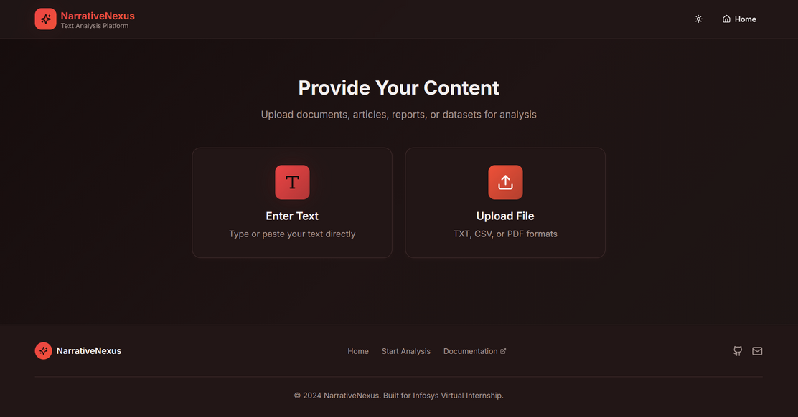
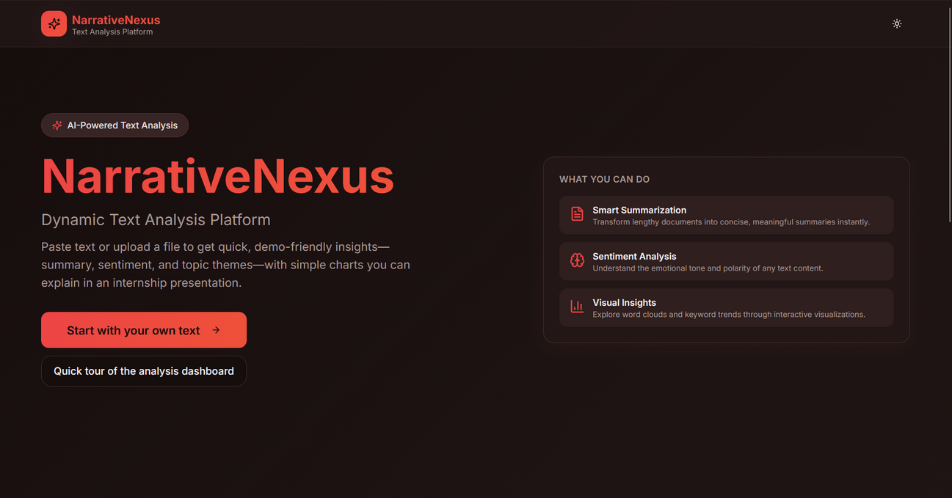
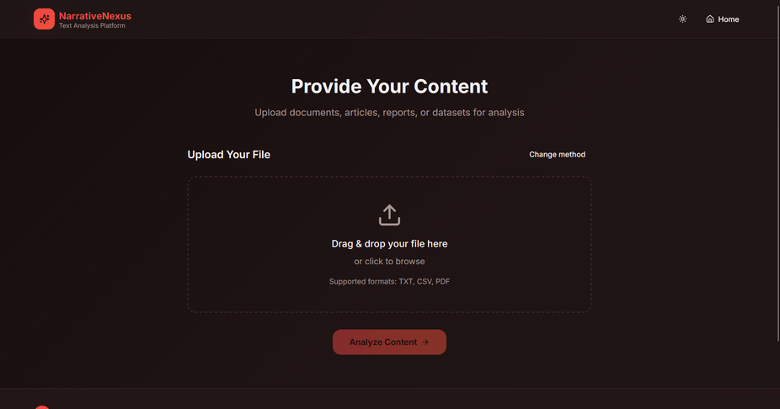
User Interface
The User Interface of NarrativeNexus is designed for simplicity and efficiency, allowing users to seamlessly upload text, initiate sentiment analysis, and generate clear visual outputs.

Slide 14
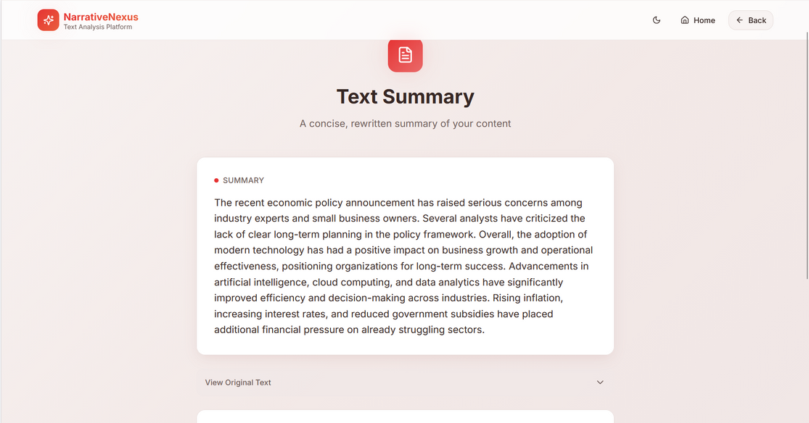
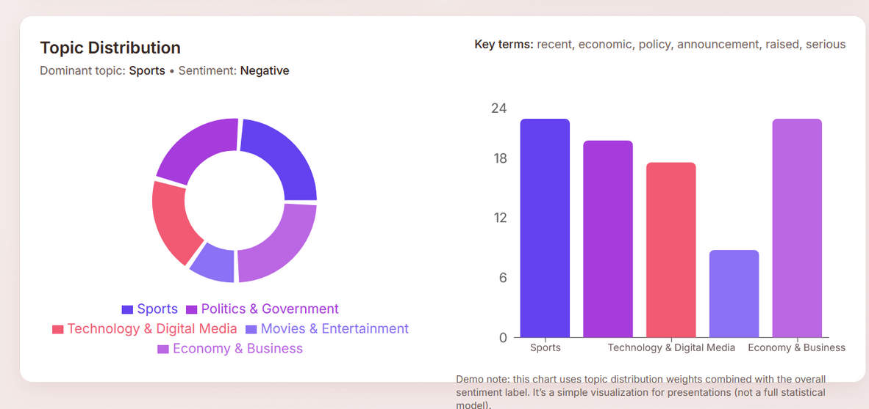
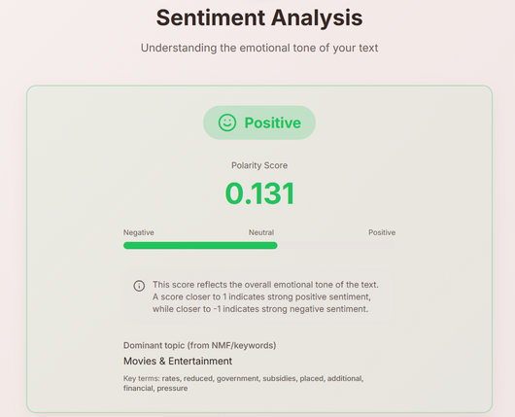
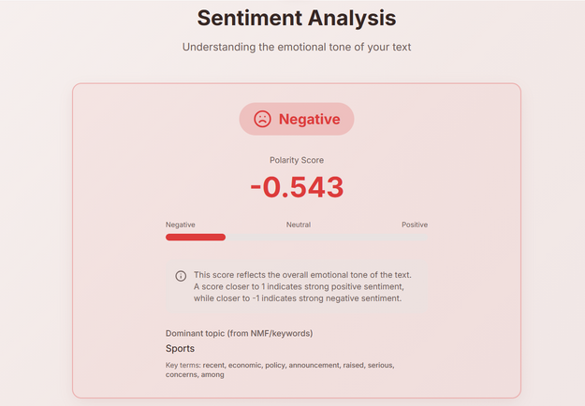
Results & Outcomes
This project achieved efficient topic discovery, accurate sentiment detection, and meaningful summaries, significantly enhancing readability and user comprehension of vast text data across various domains.

Slide 15

Challenges Faced
Navigating the complexities of our project involved overcoming obstacles such as selecting the optimal number of topics, comparing models, handling large text volumes, and integrating machine learning with user interfaces.

Slide 16
Future Enhancements
Multilingual & Domain-Specific Support: Extend analysis to multiple languages and adapt models for domains like healthcare, education, and corporate feedback.
Advanced Dashboards & Cloud Deployment: Introduce interactive dashboards with scalable cloud deployment for wider accessibility and performance.

Slide 17

Conclusion
In this project, we successfully built an end-to-end NLP system that effectively demonstrates the use of AI in text analytics, achieving our project goals through innovative solutions.

Slide 18

Thank You
CONNECT WITH ME
LinkedIn
EMAIL CONTACT
vineelapagolu@gmail.com

